Slide 1


International Economics: Theory and Policy
Twelfth Edition
Chapter 8
Firms in the Global Economy: Export and Foreign Sourcing Decisions and Multinational Enterprises
Copyright © 2022, 2018, 2015 Pearson Education, Inc. All Rights Reserved
Notes:
If this PowerPoint presentation contains mathematical equations, you may need to check that your computer has the following installed:
1) MathType Plugin
2) Math Player (free versions available)
3) NVDA Reader (free versions available)

Slide 2
Learning Objectives (1 of 2)
8.1 Understand how internal economies of scale and product differentiation lead to international trade and intra-industry trade.
8.2 Recognize the new types of welfare gains from intra-industry trade.
8.3 Describe how economic integration can lead to both winners and losers among firms in the same industry.

Slide 3
Learning Objectives (2 of 2)
8.4 Explain why economists believe that “dumping” should not be singled out as an unfair trade practice, and why the enforcement of antidumping laws leads to protectionism.
8.5 Explain why firms that engage in the global economy (exporters, outsourcers, multinationals) are substantially larger and perform better than firms that do not interact with foreign markets.
8.6 Understand theories that explain the existence of multinationals and the motivation for foreign direct investment across economies.

Slide 4
Preview
Monopolistic competition and trade
The significance of intra-industry trade
Firm responses to trade: winners, losers, and industry performance
Dumping
Multinationals and outsourcing

Slide 5
Introduction (1 of 3)
Internal economies of scale result when large firms have a cost advantage over small firms, causing the industry to become uncompetitive.
Internal economies of scale imply that a firm’s average cost of production decreases the more output it produces.

Slide 6
Introduction (2 of 3)
Perfect competition that drives the price of a good down to marginal cost would imply losses for those firms because they would not be able to recover the higher costs incurred from producing the initial units of output.
As a result, perfect competition would force those firms out of the market.
In most sectors, goods are differentiated from each other and there are other differences across firms.

Slide 7
Introduction (3 of 3)
Integration causes the better-performing firms to thrive and expand, while the worse-performing firms contract.
Additional source of gain from trade: As production is concentrated toward better-performing firms, the overall efficiency of the industry improves.
Study why those better-performing firms have a greater incentive to engage in the global economy.

Slide 8
The Theory of Imperfect Competition
In imperfect competition, firms are aware that they can influence the prices of their products and that they can sell more only by reducing their price.
This situation occurs when there are only a few major producers of a particular good or when each firm produces a good that is differentiated from that of rival firms.
Each firm views itself as a price setter, choosing the price of its product.

Slide 9
Monopoly: A Brief Review (1 of 4)
A monopoly is an industry with only one firm.
An oligopoly is an industry with only a few firms.
In these industries, the marginal revenue generated from selling more products is less than the uniform price charged for each product.
To sell more, a firm must lower the price of all units, not just the additional ones.
The marginal revenue function therefore lies below the demand function (which determines the price that customers are willing to pay).

Slide 10
Monopoly: A Brief Review (2 of 4)
Assume that the demand curve the firm faces is a
straight line
where Q is the number of units
the firm sells, P the price per unit, and A and B are constants.
Marginal revenue equals
Suppose that total costs are
where F is
fixed costs, those independent of the level of output, and
c is the constant marginal cost.

Slide 11
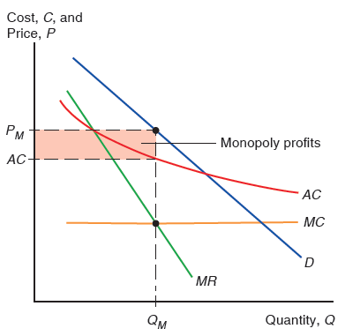
Figure 8.1 Monopolistic Pricing and Production Decisions
A monopolistic firm chooses an output at which marginal revenue, the increase in revenue from selling an additional unit, equals marginal cost, the cost of producing an additional
unit. This profit-maximizing output is shown as
the price at which this output is
demanded is
The marginal revenue curve M R lies below the demand curve D
because, for a monopoly, marginal revenue is always less than the price. The monopoly’s profits are equal to the area of the shaded rectangle, the difference between price and average cost times the amount of output sold.
Notes:
The A C curve falls with decreasing steepness above a horizontal M C curve. The D curve is a falling line crossing both the A C and M C curves. The M R curve is line to the left of the D curve that falls more steeply through the A C and M R curves. A point is plotted at the intersection of the M C and M R curves, where x = Q sub M. A dashed vertical line from x = Q sub M crosses the A C curve at y = A C, and ends at a point on the D curve where y = P sub M. Dotted horizontal lines between the y-axis and the D and A C curve form a rectangular, shaded area, with the upper side at y = P sub M and the lower side at y = A C.

Slide 12
Monopoly: A Brief Review (3 of 4)
Average cost is the cost of production (C) divided by the total quantity of production (Q).
Marginal cost is the cost of producing an additional unit of output.
A larger firm is more efficient because average cost decreases as output Q increases: internal economies of scale.

Slide 13
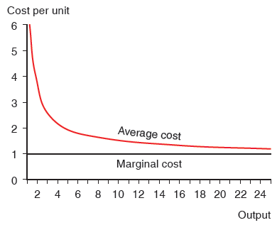
Figure 8.2 Average versus Marginal Cost
This figure illustrates the average and marginal costs corresponding to the total cost function C = 5 + x. Marginal cost is always 1; average cost declines as output rises.

Slide 14
Monopoly: A Brief Review (4 of 4)
The profit-maximizing output occurs where marginal revenue equals marginal cost.
At the intersection of the M C and M R curves, the revenue gained from selling an extra unit equals the cost of producing that unit.
The monopolist earns some monopoly profits, as
indicated by the shaded box, when

Slide 15
Monopolistic Competition (1 of 9)
Monopolistic competition is a simple model of an imperfectly competitive industry that assumes that each firm
can differentiate its product from the product of competitors, and
takes the prices charged by its rivals as given.

Slide 16
Monopolistic Competition (2 of 9)
A firm in a monopolistically competitive industry is expected to sell
more as total sales in the industry increase and as prices charged by rivals increase.
less as the number of firms in the industry decreases and as the firm’s price increases.
These concepts are represented by the function:

Slide 17
Monopolistic Competition (3 of 9)
Q is an individual firm’s sales
S is the total sales of the industry
n is the number of firms in the industry
b is a constant term representing the responsiveness of a firm’s sales to its price
is the price charged by the firm itself
P is the average price charged by its competitors

Slide 18
Monopolistic Competition (4 of 9)
Assume that firms are symmetric: all firms face the same demand function and have the same cost function.
Thus all firms should charge the same price and have
equal share of the market
Average costs should depend on the size of the market and the number of firms:

Slide 19
Monopolistic Competition (5 of 9)
As the number of firms n in the industry increases, the average cost increases for each firm because each produces less.
As total sales S of the industry increase, the average cost decreases for each firm because each produces more.

Slide 20
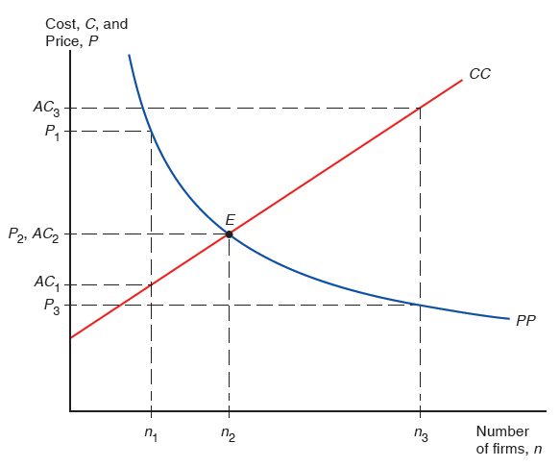
Figure 8.3 Equilibrium in a Monopolistically Competitive Market
The number of firms in a monopolistically competitive market, and the prices they charge, are determined by two relationships. On one side, the more firms there are, the more intensely they compete, and hence the lower is the industry price. This relationship is represented by P P. On the other side, the more firms there are, the less each firm sells and therefore the higher is the industry’s average cost. This relationship is represented by C C. If price exceeds average cost (that is, if the P P curve is above the C C curve), the industry will be making profits and additional firms will enter the industry; if price is less than average cost, the industry will be incurring losses and firms will leave the industry. The equilibrium price and number of firms occurs when price equals average cost, at the intersection of PP and C C.
Notes:
A rising line, C C, begins at the y-axis and passes through point E. A curve, P P, falls with decreasing steepness and intersects C C at point E, with coordinates (n sub 2, P sub 2, A C sub 2), shown by dotted lines. Additional dotted lines from x and y-values form points of intersection as follows: (n sub 1, P sub 1) in the upper section of P P; (n sub 1, A C sub 1) in the lower section of C C; (n sub 3, P sub 3) in the lower portion of P P; and (n sub 3, A C sub 3) in the upper portion of C C.

Slide 21
Monopolistic Competition (6 of 9)
If monopolistic firms face linear demand functions,
where A and B are constants.
When firms maximize profits, they should produce until marginal revenue equals marginal cost:

Slide 22
Monopolistic Competition (7 of 9)
As the number of firms n in the industry increases, the price that each firm charges decreases due to increased competition.
Each firm’s markup over marginal cost
decreases with the number of competing firms.

Slide 23
Monopolistic Competition (8 of 9)
At some number of firms, the price that firms charge (which decreases in n) matches the average cost that firms pay (which increases in n).
At this long-run equilibrium number of firms in the industry, firms have no incentive to enter or exit the industry.

Slide 24
Monopolistic Competition (9 of 9)
If the number of firms is greater than or less than the equilibrium number, then firms have an incentive to exit or enter the industry.
Firms have an incentive to exit the industry when price < average cost.
Firms have an incentive to enter the industry when price > average cost.

Slide 25
Monopolistic Competition and Trade (1 of 2)
Because trade increases market size, trade is predicted to decrease average cost in an industry described by monopolistic competition.
Industry sales increase with trade leading to decreased
average costs:
Because trade increases the variety of goods that consumers can buy under monopolistic competition, it increases the welfare of consumers.
And because average costs decrease, consumers can also benefit from a decreased price.

Slide 26
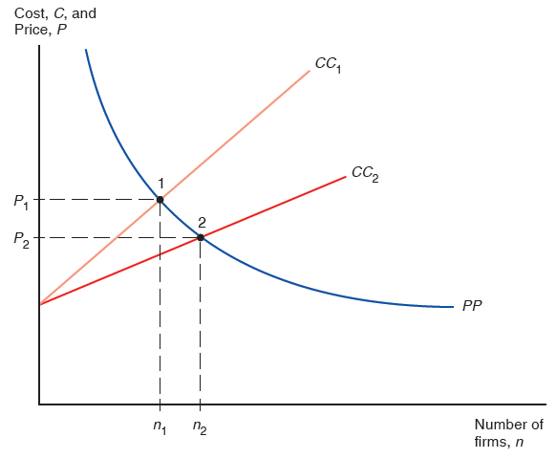
Figure 8.4 Effects of a Larger Market
An increase in the size of the market allows each firm, other things equal, to produce more and thus have lower average cost. This is represented by a downward shift from
The result is a simultaneous increase in the number of firms (and hence in
the variety of goods available) and a fall in the price of each.
Notes:
2 curves, C C sub 1 and C C sub 2, begin at the same point on the y-axis and rise as straight lines. C C sub 1 rises more steeply than C C sub 2. The P P curve falls with decreasing steepness, crossing curve C C sub 1 at point 1, (n sub 1, P sub 1), and C C sub 2 at point 2, (n sub 2, P sub 2).

Slide 27
Gains from an Integrated Market: A Numerical Example (1 of 3)
Suppose that
fixed cost F = $750,000,000,
and a marginal cost of c = $5,000 per automobile.
The total cost is
The average cost is therefore

Slide 28
Gains from an Integrated Market: A Numerical Example (2 of 3)
Suppose there are two countries, Home and Foreign.
Home has annual sales of 900,000 automobiles; Foreign has annual sales of 1.6 million.
The two countries are assumed (for now) to have the same costs of production.

Slide 29
Gains from an Integrated Market: A Numerical Example (3 of 3)
The integrated market supports more firms, each producing at a larger scale and selling at a lower price than either national market does on its own.
Everyone is better off as a result of the larger market with integration:
Consumers have a wider range of choices, and
Each firm produces more and is therefore able to offer its product at a lower price.

Slide 30
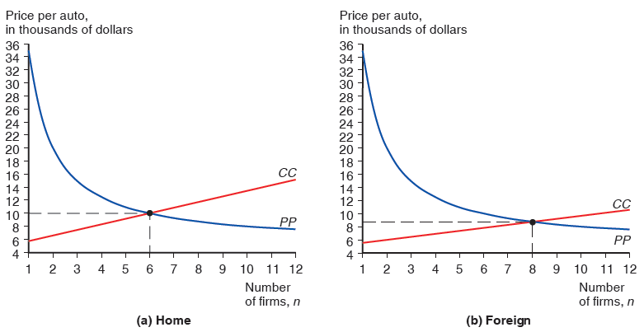
Figure 8.5 Equilibrium in the Automobile Market (1 of 2)
(a) The Home market: With a market size of 900,000 automobiles, Home’s equilibrium, determined by the intersection of the PP and CC curves, occurs with six firms and an industry price of $10,000 per auto. (b) The Foreign market: With a market size of 1.6 million automobiles, Foreign’s equilibrium occurs with eight firms and an industry price of $8,750 per auto.
Notes:
Graphs, a and b plot price per auto in thousands of dollars versus number of firms, n. The curve P P is a falling curve, that starts on the y axis at y = 35 and falls with decreasing steepness intersecting line C C, on each graph. The curve C C is a rising line, with differing slopes on each graph. The following list provides rise of C C and point of intersection for each graph. Graph a, home. C C rises from (1, 5) through (12, 15), and intersects curve P P at (6, 10). Graph b, foreign. C C rises from (1, 5) through (12, 11), and intersects curve P P at (8, 9). All values are estimated

Slide 31
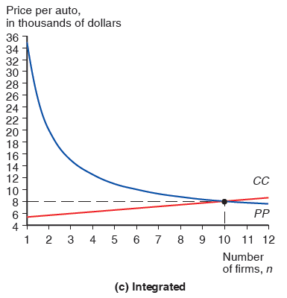
Figure 8.5 Equilibrium in the Automobile Market (2 of 2)
(c) The combined market: Integrating the two markets creates a market for 2.5 million autos. This market supports 10 firms, and the price of an auto is only $8,000.

Slide 32
Table 8.1 Hypothetical Example of Gains from Market Integration
Blank | Home Market before Trade | Foreign Market, before Trade | Integrated Market, after Trade
Industry output (# of autos) | 900,000 | 1,600,000 | 2,500,000
Number of firms | 6 | 8 | 10
Output per firm (# of autos) | 150,000 | 200,000 | 250,000
Average cost | $10,000 | $8,750 | $8,000
Price | $10,000 | $8,750 | $8,000

Slide 33
Monopolistic Competition and Trade (2 of 2)
Product differentiation and internal economies of scale lead to trade between similar countries with no comparative advantage differences between them.
This is a very different kind of trade than the one based on comparative advantage, where each country exports its comparative advantage good.

Slide 34
The Significance of Intra-Industry Trade (1 of 2)
Intra-industry trade refers to two-way exchanges of similar goods.
Two new channels for welfare benefits from trade:
Benefit from a greater variety at a lower price.
Firms consolidate their production and take advantage of economies of scale.
A smaller country stands to gain more from integration than a larger country.

Slide 35
The Significance of Intra-Industry Trade (2 of 2)
About 25–50% of world trade is intra-industry.
Most prominent is the trade of manufactured goods among advanced industrial nations, which accounts for the majority of world trade.
For the United States, industries that have the most intra-industry trade—such as pharmaceuticals, chemicals, and specialized machinery—require relatively larger amounts of skilled labor, technology, and physical capital.

Slide 36
Table 8.2 Indexes of Intra-Industry Trade for U.S. Industries, 2009
Metalworking Machinery | 0.97
Inorganic Chemicals | 0.97
Power-Generating Machines | 0.86
Medical and Pharmaceutical Products | 0.85
Scientific Equipment | 0.84
Organic Chemicals | 0.79
Iron and Steel | 0.76
Road Vehicles | 0.70
Office Machines | 0.58
Telecommunication Equipment | 0.46
Furniture | 0.30
Clothing and Apparel | 0.11
Footwear | 0.10

Slide 37
Intra-Industry Trade in Action: The North American Auto Pact of 1964 and N A F T A (1 of 5)
Before 1965, tariff protection by Canada and the United States produced a Canadian auto industry that was largely self-sufficient, neither importing nor exporting much.
The Canadian auto industry was about one-tenth the size of the United States and had a labor productivity about 30% lower than that of the United States.
Most Canadian plants produced several different things, requiring the plants to shut down periodically to change over from producing one item to producing another, to hold larger inventories, to use less specialized machinery.

Slide 38
Intra-Industry Trade in Action: The North American Auto Pact of 1964 and N A F T A (2 of 5)
The United States and Canada agreed in 1964 to establish free trade in automobiles, which allowed the auto companies to reorganize their production.
The overall level of Canadian production and employment was maintained.
Canadian subsidiaries cut how many products were made in Canada. Production levels for the models produced in Canada rose dramatically, as those Canadian plants became one of the main (or only) supplier of that model for the whole North American market.
Canada imported the models from the United States that it was no longer producing.

Slide 39
Intra-Industry Trade in Action: The North American Auto Pact of 1964 and N A F T A (3 of 5)
Both exports and imports increased sharply.
By the early 1970s, the Canadian industry was comparable to the U.S. industry in productivity.
Later on, this transformation of the automotive industry was extended to include Mexico.
This process continued with the implementation of N A F T A (the North American Free Trade Agreement between the United States, Canada, and Mexico).
For each model of car, there is typically a plant in one of these three countries that sells to the whole North American market.

Slide 40
Intra-Industry Trade in Action: The North American Auto Pact of 1964 and N A F T A (4 of 5)
The manufacture of auto parts was also consolidated throughout the North American market.
In the first decade following N A F T A, trade in automotive parts between the United States and Mexico more than doubled in both directions, and then doubled again in the ensuing decade, highlighting the increasing importance of intra-industry trade.

Slide 41
Intra-Industry Trade in Action: The North American Auto Pact of 1964 and N A F T A (5 of 5)
Concerns raised over a few final assembly plants relocating from the United States to Mexico rarely mentions the large growth of U.S. autos and parts exports to Mexico: Over two-thirds of Mexican automotive imports originated in the United States in 2002.
Ending N A F T A likely would not would not result in higher car production in the United States.
Lower demand for U.S. imports in Mexico and Canada (along with higher prices for all consumers) would lead to lower car production in the United States.
Only car production outside North America would increase.

Slide 42
Firm Responses to Trade
Increased competition tends to hurt the worst-performing firms — they are forced to exit.
The best-performing firms take the greatest advantage of new sales opportunities and expand the most.
When the better-performing firms expand and the worse-performing ones contract or exit, overall industry performance improves.
Trade and economic integration improve industry performance as much as the discovery of a better technology does.

Slide 43
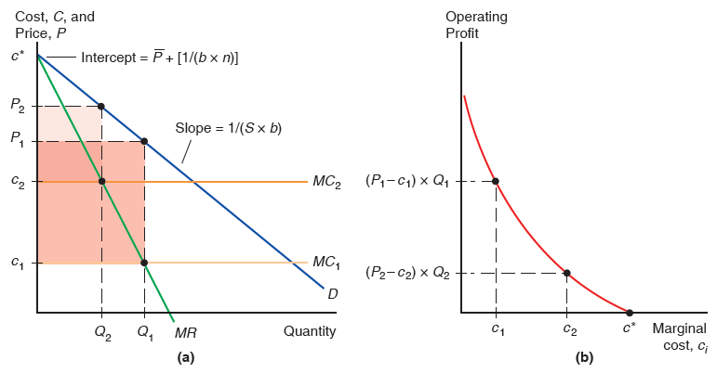
Figure 8.6 Performance Differences across Firms
(a) Demand and cost curves for firms 1 and 2. Firm 1 has a lower marginal cost than firm
Both firms face the same demand curve and marginal revenue curve. Relative
to firm 2, firm 1 sets a lower price and produces more output. The shaded areas
represent operating profits for both firms (before the fixed cost is deducted). Firm 1 earns higher operating profits than firm 2. (b) Operating profits as a function of a firm’s marginal cost c i. Operating profits decrease as the marginal cost increases. Any firm with marginal
cost above
cannot operate profitably and shuts down.
Notes:
Each firm has a horizontal marginal cost line. M C sub 1, at y = c sub 1, is below M C sub 2, at y = c sub 2. The D curve and M R both begin at the y-intercept, c asterisk = P bar +, left bracket, 1 over, left parenthesis b times n, right parenthesis, right bracket. The D curve with slope = 1 over, S times b, is a falling line intersecting both M C curves. The M R curve is a steeper falling line, to the left of the D curve. The intersection of M R and M C sub 1 is at point (Q sub 1, c sub 1); the point forms the lower right vertex of a shaded rectangle. Point (Q sub 1, P sub 1) is the upper right vertex of the rectangle. The y-axis is the left boundary of the shaded rectangle. A second shaded rectangle is smaller and also has the y-axis as the left boundary. The lower right vertex is the intersection of M R and M C sub 2, (Q sub 2, C sub 2). The upper right vertex is on the D curve, (Q sub 2, P sub 2). Graph b shows operating profit versus marginal cost, c sub i. The curve falls from the y-axis with decreasing steepness through (c sub 1, P sub 1 minus c sub 1, times, Q sub 1) and (c sub 2, sub 2 minus c sub 2, times, Q sub 2) to point c asterisk on the x-axis.

Slide 44
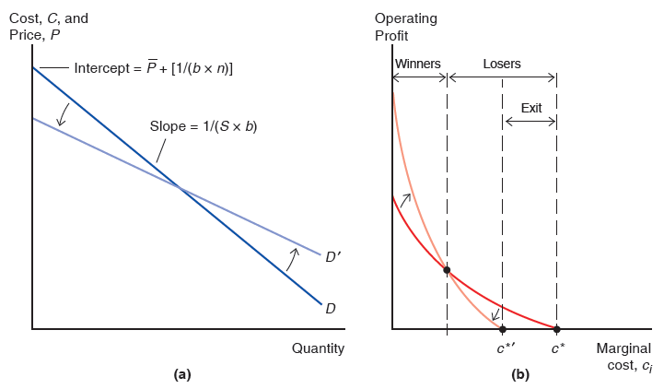
Figure 8.7 Winners and Losers from Economic Integration
(a) The demand curve for all firms changes from D to
It is flatter, and has
a lower vertical intercept. (b) Effects of the shift in demand on the operating profits of
firms with different marginal cost
Firms with marginal cost between the old cutoff,
and the new one,
are forced to exit. Some firms with the lowest
marginal cost levels gain from integration and their profits increase.
Notes:
Demand curve D is a falling line with slope = 1 over, S times b, and a y-intercept = P bar +, left bracket, 1, over, left parenthesis, b times n, right parenthesis, right bracket. The D curve shifts, to a lower y-intercept and lesser slope for the second curve, D prime. Graph b plots operating profit versus marginal cost, c sub i. The original curve is divided on the x-axis into 3 segments from left to right: winners form the first segment, losers forms segments 2 and 3; the third segment further breaks down into, exit. The curve falls with decreasing steepness to c asterisk on the x-axis, at the right end of, exit. The curve is rotated to move the x-intercept left to c asterisk prime, with higher y-values increase on a higher curve. C asterisk prime is at the point between the first losers segment and, exit. The intersection of the 2 curves is the point where winners and losers meet. The distance between c asterisk and c asterisk prime is where firms exit the market.

Slide 45
Trade Costs and Export Decisions (1 of 4)
Most U.S. firms do not report any exporting activity at all — sell only to U.S. customers.
In 2007, only 35% of U.S. manufacturing firms reported any exports.
Even in industries that export much of what they produce, such as chemicals, machinery, electronics, and transportation, fewer than 40% of firms export.
A major reason why trade costs reduce trade so much is that they drastically reduce the number of firms selling to customers across the border.
Trade costs also reduce the volume of export sales of firms selling abroad.

Slide 46
Table 8.3 Proportion of U.S. Firms Reporting Export Sales by Industry, 2007
Printing | 15%
Furniture | 16%
Wood Products | 21%
Apparel | 22%
Fabricated Metal | 30%
Petroleum and Coal | 34%
Transportation Equipment | 57%
Machinery | 61%
Chemicals | 65%
Electrical Equipment and Appliances | 70%
Computer and Electronics | 75%

Slide 47
Trade Costs and Export Decisions (2 of 4)
Trade costs added two important predictions to our model of monopolistic competition and trade:
Why only a subset of firms export, and why exporters are relatively larger and more productive (lower marginal costs).
Overwhelming empirical support for this prediction that exporting firms are bigger and more productive than firms in the same industry that do not export.
In the United States, in a typical manufacturing industry, an exporting firm is on average more than twice as large as a firm that does not export.
Differences between exporters and nonexporters are even larger in many European countries.

Slide 48
Trade Costs and Export Decisions (3 of 4)
Consider the response of firms in a world with two identical countries (Home and Foreign).
Let the market size parameter S reflect the size of each market.
Assume that a firm must incur an additional cost t for each unit of output that it sells to customers across the border.
Due to the trade cost t, firms will set different prices in their export market relative to their domestic market.

Slide 49
Trade Costs and Export Decisions (4 of 4)
In Figure 8-8, firm 2 profitably operates in its domestic
market as its cost there
is below the threshold
However, it cannot profitably operate in the export
market because its cost there
is above the
threshold
Firm 1 has a low enough cost that it profitably operates in both the domestic and the export markets.
Overall, the lowest-cost firms export; the higher-cost firms produce for their domestic market but do not export; the highest-cost firms cannot profitably operate in either market and thus exit.

Slide 50
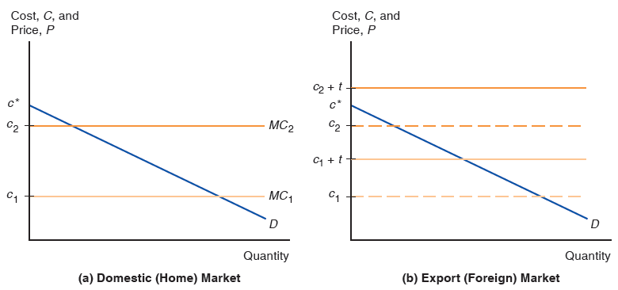
Figure 8.8 Export Decisions with Trade Costs
(a) Firms 1 and 2 both operate in their domestic (Home) market. (b) Only firm 1 chooses to export to the Foreign market. It is not profitable for firm 2 to export given the trade cost t.
Notes:
Both have demand curves that intersect horizontal marginal cost lines, 1 and 2. Graph ay is the domestic, home market. The D curve begins at the y-intercept c asterisk, and is a falling line intersecting M C sub 2 at y = c sub 2, and M C sub 1 at y = c sub 1. Graph b is the export, foreign market and has the same D curve and the previous M C 1 and 2 as dashed lines. Two additional M C lines have shifted up to c sub 1 + t, and c sub 2 + t, respectively. The D curve does not cross the top M C sub 2 line as the y-intercept of the D curve is c asterisk, midway between y = c sub 2 and y = c sub 2 + t.

Slide 51
Dumping (1 of 2)
Dumping is the practice of charging a lower price for exported goods than for goods sold domestically.
Dumping is an example of price discrimination: the practice of charging different customers different prices.
Price discrimination and dumping may occur only if
imperfect competition exists: firms are able to influence market prices.
markets are segmented so that goods are not easily bought in one market and resold in another.

Slide 52
Dumping (2 of 2)
Dumping can be a profit-maximizing strategy:
A firm with a higher marginal cost chooses to set a lower markup over marginal cost.
Therefore, an exporting firm will respond to the trade cost by lowering its markup for the export market.
This strategy is considered to be dumping, regarded by most countries as an “unfair” trade practice.

Slide 53
Protectionism and Dumping (1 of 5)
A U.S. firm may appeal to the Commerce Department to investigate if dumping by foreign firms has injured the U.S. firm.
The Commerce Department may impose an “anti-dumping duty” (tax) to protect the U.S. firm.
Tax equals the difference between the actual and “fair” price of imports, where “fair” means “price the product is normally sold at in the manufacturer’s domestic market.”

Slide 54
Protectionism and Dumping (2 of 5)
Next, the International Trade Commission (I T C) determines if injury to the U.S. firm has occurred or is likely to occur.
If the I T C determines that injury has occurred or is likely to occur, the antidumping duty remains in place.

Slide 55
Protectionism and Dumping (3 of 5)
Most economists believe that the enforcement of dumping claims is misguided.
Trade costs have a natural tendency to induce firms to lower their markups in export markets.
Such enforcement may be used excessively as an excuse for protectionism.
In the early 1990s, the bulk of antidumping complaints were directed at developed countries.
But since 1995, developing countries have accounted for the majority of antidumping complaints.
Among those countries, China has attracted a particularly large number of complaints.

Slide 56
Protectionism and Dumping (4 of 5)
A nonmarket economy with substantial export growth, China has been subject to antidumping duties on:
T Vs, furniture, crepe paper, hand trucks, shrimp, ironing tables, plastic shopping bags, iron pipe fittings, saccharin, solar panels, tires, and cold-rolled steel.
These duties are as high as 78% on color T Vs, 266% for cold-rolled steel, and 330% on saccharin.
Chinese cost data likely distorted by subsidized loans, rigged markets, and the controlled yuan.
Data from other developing nations regarded as market economies used instead.

Slide 57
Protectionism and Dumping (5 of 5)
Because antidumping protection is directed at a particular firm producing in a given country, often circumvented by firms switching production location or new firms that were not originally targeted by the antidumping filing.
When U.S. tire manufacturers successfully lobbied for antidumping duties on Chinese tires in 2009, production shifted to South Korea, Thailand, and Indonesia. Exports from those countries doubled, offsetting the decrease in tire imports from China.
Similarly L G and Samsung moved washing machine production from Korea to China and then Vietnam and Thailand to avoid paying antidumping duties.

Slide 58
Multinationals and Outsourcing (1 of 6)
Foreign direct investment refers to investment in which a firm in one country directly controls or owns a subsidiary in another country.
If a foreign company invests in at least 10% of the stock in a subsidiary, the two firms are typically classified as a multinational corporation.
10% or more of ownership in stock is deemed to be sufficient for direct control of business operations.
The controlling (owning) firm is called the multinational parent, while the “controlled” firms are called the multinational affiliates.

Slide 59
Multinationals and Outsourcing (2 of 6)
Greenfield F D I is when a company builds a new production facility abroad.
Brownfield F D I (or cross-border mergers and acquisitions) is when a domestic firm buys a controlling stake in a foreign firm.
Greenfield F D I has tended to be more stable, while cross-border mergers and acquisitions tend to occur in surges.

Slide 60
Multinationals and Outsourcing (3 of 6)
Developed countries have been the biggest recipients of inward F D I.
much more volatile than F D I going to developing and transition economies.
Steady expansion in the share of F D I flowing to developing and transition countries.
Accounted for half of worldwide F D I flows since 2009.
Sales of F D I affiliates are often used as a measure of multinational activity.

Slide 61
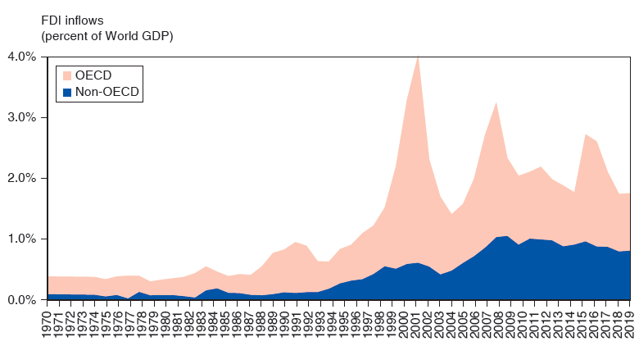
Figure 8.9 Inflows of Foreign Direct Investment, 1970–2019 (Percent of World G D P)
Worldwide flows of F D I have significantly increased since the mid-1990s, though the rates of increase have been very uneven. Historically, most of the inflows of F D I have gone to the developed countries in the O E C D. However, the proportion of F D I inflows going to developing and transition economies has steadily increased over time and accounted for roughly half of worldwide F D I flows since 2009.
Source: United Nations Conference on Trade and Development, World Investment Report, 2019.
Notes:
A double line graph for O E C D countries and non O E C D countries displays foreign direct investment inflows in billions of U S dollars versus year, 19 70 to 20 19. The area under each line is shaded. The plot for O E C D countries generally rises from (19 70, 0) through (19 95, 1.0%) to (2000, 4.0%), then dips to (2003, 1.5%), and rises again to (2007, 3.3%). From there, it rises and falls to (20 19, 2.0%). The plot for non O E C D countries generally rises from (1970, 0) through (1995, 0.3%) to (2000, 0.7%), dips to (2003, 0.5%), then generally rises through (2007, 1.0%) to (20 19, 0.9%). All values are estimated.

Slide 62
Multinationals and Outsourcing (4 of 6)
Two main types of F D I:
Horizontal F D I when the affiliate replicates the production process (that the parent firm undertakes in its domestic facilities) elsewhere in the world.
Vertical F D I when the production chain is broken up, and parts of the production processes are transferred to the affiliate location.

Slide 63
Multinationals and Outsourcing (5 of 6)
Vertical F D I is mainly driven by production cost differences between countries (for those parts of the production process that can be performed in another location).
Vertical F D I is growing fast and is behind the large increase in F D I inflows to developing countries.

Slide 64
Multinationals and Outsourcing (6 of 6)
Horizontal F D I is dominated by flows between developed countries.
Both the multinational parent and the affiliates are usually located in developed countries.
The main reason for this type of F D I is to locate production near a firm’s large customer bases.
Hence, trade and transport costs play a much more important role than production cost differences for these F D I decisions.

Slide 65
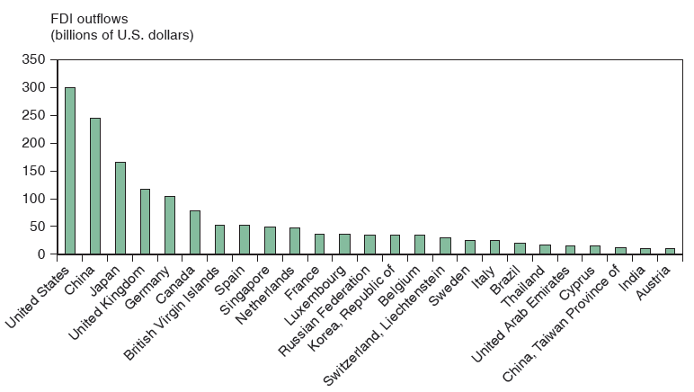
Figure 8.10 Outward Foreign Direct Investment for Top 25 Countries, Yearly Average 2017–2019
Developed countries dominate the list of the top countries whose firms engage in outward F D I. More recently, firms from some big developing countries such as China and India have performed significantly more F D I.
Source: United Nations Conference on Trade and Development, World Investment Report, 2019.
Notes:
The bar graph plots F D I outflows in billions of U S dollars versus countries arranged from the ones with the most outward foreign direct investment to the least as a yearly average for 20 17 to 20 19. The following list provides F D I outflows in billions of U S dollars, by country. United States, 300. China, 250. Japan, 170. United Kingdom, 130. Germany 120. Canada, 90. British Virgin Islands, 55. Spain, 60. Singapore, 55. Netherlands, 58. France, 48. Luxembourg, 48. Russian Federation, 47. Republic of Korea, 47. Belgium, 47. Switzerland, Liechtenstein, 46. Sweden, 45. Italy, 44. Brazil, 42. Thailand, 40. United Arab Emirates, 38. Cyprus, 38. China, Taiwan province of, 30. India, 30. Austria, 30. All values are estimated.

Slide 66
The Firm’s Decision Regarding Foreign Direct Investment (1 of 8)
Proximity-concentration trade-off:
High trade costs associated with exporting create an incentive to locate production near customers.
Increasing returns to scale in production create an incentive to concentrate production in fewer locations.

Slide 67
The Firm’s Decision Regarding Foreign Direct Investment (2 of 8)
F D I activity concentrated in sectors with high trade costs.
When increasing returns to scale are important and average plant sizes are large, we observe higher export volumes relative to F D I.
Multinationals tend to be much larger and more productive than other firms (even exporters) in the same country.

Slide 68
The Firm’s Decision Regarding Foreign Direct Investment (3 of 8)
The horizontal FDI decision involves a trade-off between the per-unit export cost t and the fixed cost F of setting up an additional production facility.
If
costs more to pay trade costs t on Q units sold
abroad than to pay fixed cost F to build a plant abroad.
When foreign sales large
exporting is more
expensive and F D I is the profit-maximizing choice.
Low costs make more apt to choose F D I due to larger sales.

Slide 69
The Firm’s Decision Regarding Foreign Direct Investment (4 of 8)
The vertical F D I decision also involves a trade-off between cost savings and the fixed cost F of setting up an additional production facility.
Cost savings related to comparative advantage make some stages of production cheaper in other countries.

Slide 70
The Firm’s Decision Regarding Foreign Direct Investment (5 of 8)
Foreign outsourcing or offshoring occurs when a firm contracts with an independent firm to produce in the foreign location.
In addition to deciding the location of where to produce, firms also face an internalization decision: whether to keep production done by one firm or by separate firms.

Slide 71
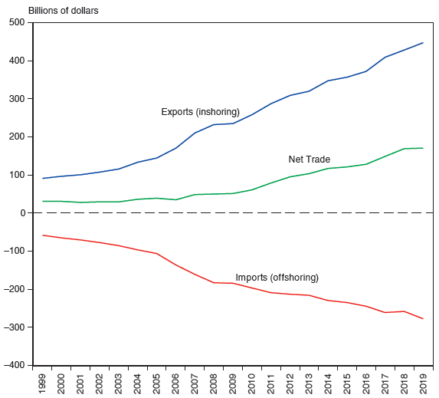
Figure 8.12 U.S. International Trade in Business Services, 1999–2019
U.S. service offshoring is captured by U.S. imports of business services. Although service offshoring has dramatically increased over the past decade, U.S. inshoring (exports of business services) has grown even faster. The net balance is positive and has also substantially increased over the past decade.
Notes:
A triple line graph plots exports or in shoring, net trade, and imports or off shoring in billions of dollars versus year, 19 99 to 20 19. The plot for export, in shoring, rises from (19 99, 100) through (2009, 250) to (20 19, 450). The plot for net trade generally rises from (19 99, 30) through (2009, 50) to (20 19, 160). The plot for imports, off shoring, falls from (19 99, negative 50) through (2009, negative 180) to (20 19, negative 260). All values are estimated.

Slide 72
The Firm’s Decision Regarding Foreign Direct Investment (6 of 8)
Internalization occurs when it is more profitable to conduct transactions and production within a single organization. Reasons for this include:
Technology transfers: transfer of knowledge or another form of technology may be easier within a single organization than through a market transaction between separate organizations.
Patent or property rights may be weak or nonexistent.
Knowledge may not be easily packaged and sold.

Slide 73
The Firm’s Decision Regarding Foreign Direct Investment (7 of 8)
Vertical integration involves consolidation of different stages of a production process.
Consolidating an input within the firm using it can avoid holdup problems and hassles in writing complete contracts.
But an independent supplier could benefit from economies of scale if it performs the process for many parent firms.

Slide 74
The Firm’s Decision Regarding Foreign Direct Investment (8 of 8)
Foreign direct investment should benefit the countries involved for reasons similar to why international trade generates gains.
Multinationals and firms that outsource take advantage of cost differentials that favor moving production (or parts thereof) to particular locations.
F D I is very similar to the relocation of production that occurred across sectors when opening to trade.
There are similar welfare consequences for the case of multinationals and outsourcing: Relocating production to take advantage of cost differences leads to overall gains from trade.

Slide 75
Whose Trade Is It? (1 of 4)
Large bilateral trade deficit between the United States and China.
$344 billion in 2019,
accounts for 56% of the overall U.S. trade deficit (in goods and services) with the rest of the world,
prominently featured in the press and by politicians (often as a sign of unfair trade practices).

Slide 76
Whose Trade Is It? (2 of 4)
Buying an iPhone 11 Pro Max from Apple in the United States is recorded as a $490 import from China (where the iPhone is assembled and tested).
Of this total manufacturing cost, less than $10 stems from assembly and testing performed in China.
The remaining $480 represents the iPhone’s component costs, which are overwhelmingly produced outside China.
spread throughout Asia (Korea, Japan, and Taiwan are the largest suppliers), Europe, and the Americas.

Slide 77
Whose Trade Is It? (3 of 4)
Seventy-five sites in the United States contribute to the production of iPhone components and employ 257,000 U.S. workers.
For example, the glass screens are produced in Kentucky and the Face I D chips in Texas.
Many of the component producers outside the United States employ U.S. researchers and engineers.
For example, the Korean company Samsung operates research facilities in Texas and California that employ several thousand workers.

Slide 78
Whose Trade Is It? (4 of 4)
The true bilateral deficit between the United States and China (at value added) is estimated to be roughly half of the reported bilateral trade deficit based on gross value.
The trade deficits with Germany, Japan, and Korea are magnified when measured as value added, because those countries manufacture many of the components that are assembled in China and then imported as final goods into the United States.
Leaves the overall U.S. trade deficit (with the rest of the world) unchanged.

Slide 79
Summary (1 of 4)
Internal economies of scale imply that more production at the firm level causes average costs to fall.
With monopolistic competition, each firm can raise prices somewhat above those on competing products due to product differentiation but must compete with other firms whose prices are believed to be unaffected by each firm’s actions.
Monopolistic competition allows for gains from trade through lower costs and prices, as well as through wider consumer choice.

Slide 80
Summary (2 of 4)
Monopolistic competition predicts intra-industry trade, and does not predict changes in income distribution within a country.
Location of firms under monopolistic competition is unpredictable, but countries with similar relative factors are predicted to engage in intra-industry trade.

Slide 81
Summary (3 of 4)
Dumping may be a profitable strategy when a firm faces little competition in its domestic market and faces heavy competition in foreign markets.
Multinationals are typically larger and more productive than exporters, which in turn are larger and more efficient than firms that sell only to the domestic market.

Slide 82
Summary (4 of 4)
Multinational corporations undertake foreign direct investment when proximity is more important than concentrating production in one location
Firms produce where it is most cost-effective — abroad if the scale is large enough. They replicate entire production process abroad or locate stages in different countries.
Firms also decide whether to keep transactions within the firm or contract with another firm.

Slide 83

Copyright
This work is protected by United States copyright laws and is provided solely for the use of instructors in teaching their courses and assessing student learning. Dissemination or sale of any part of this work (including on the World Wide Web) will destroy the integrity of the work and is not permitted. The work and materials from it should never be made available to students except by instructors using the accompanying text in their classes. All recipients of this work are expected to abide by these restrictions and to honor the intended pedagogical purposes and the needs of other instructors who rely on these materials.

